Slide 1
Quantum Learning Project
Name: Ankur Rai
Instructor: Karan Mehta

Slide 2
Projects
Bengaluru House data
Company attrition data
Diamond price prediction
Fraud dataset

Slide 3
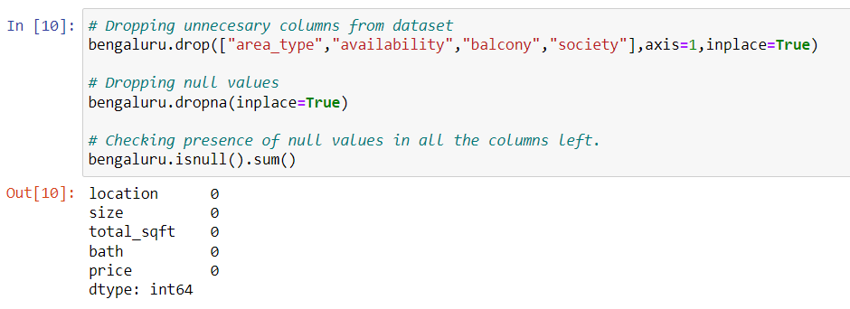
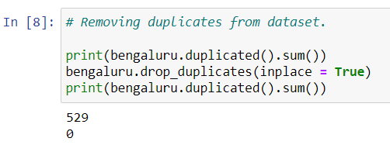
Challenges
Bengaluru house data
To get the house price in bangalore was quite tough given the statistics of train data without modification as– and test data as – with an accuracy of 85%. To reach that accuracy, following was done:
In dealing with the bengaluru house dataset, I first dropped the duplicate values in the data preprocessing step. After this step,
We check for the null values and dropped them with columns such as area_type,availability,balcony and society.

Slide 4
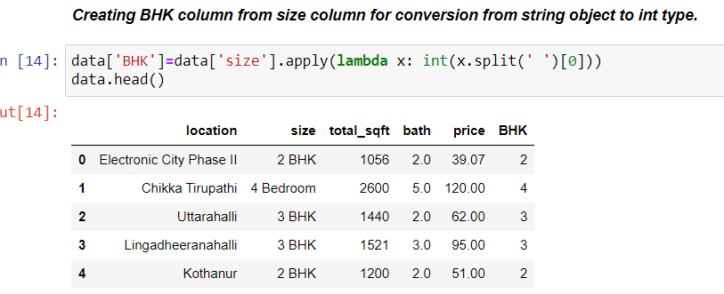
Bengaluru house data
In data visualisation, we generate BHK column from size column to have an INT object.

Slide 5
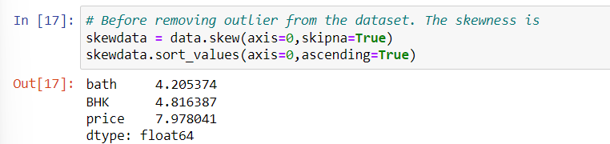
Bengaluru house data
In this step, we came to see the skewness in the data for bath,BHK and price which can affect our model.

Slide 6
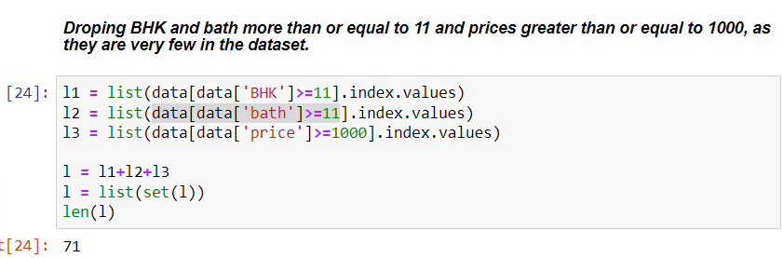
Bengaluru house data
In outlier removal step, i first check the skewness in the data and acted along with the values. As we can see house having BHK>11 are very less in number. Like that house with bath>11 and price >=1000 are very less in number. These data account for total 71 rows in the dataset, which i considered to drop to reduce the skewness. I stopped after an appreciable drop in skew value and did not proceed further as change in one increase skewness in other column.

Slide 7
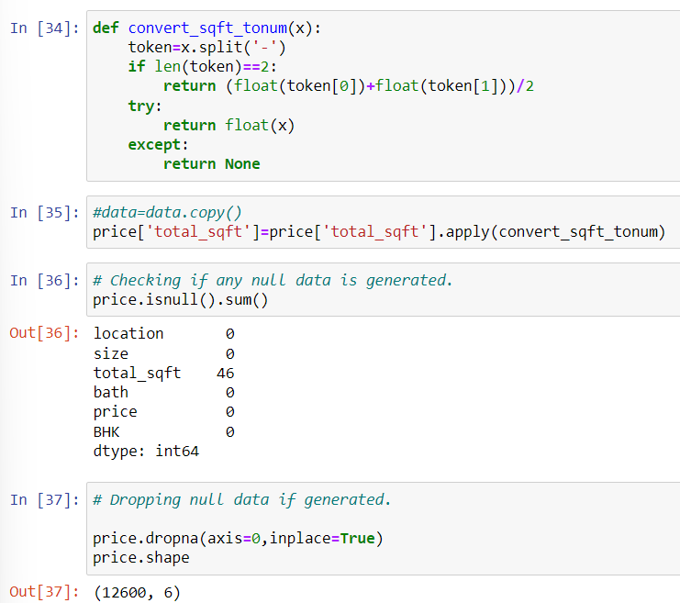
Bengaluru house data
As the total_sqft is an object column to convert it into float we proceeded further. After converting it to float, again checked for null values as their were values like 34.46sq. Meter which were changed to empty string. So i consider to drop them as well

Slide 8
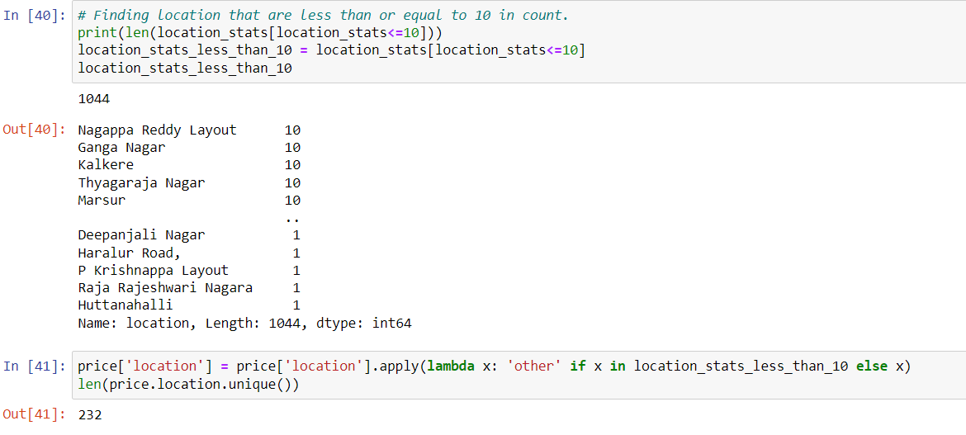
Bengaluru house data
Then we change the location which were <=10 to others and dropped them afterwards.

Slide 9
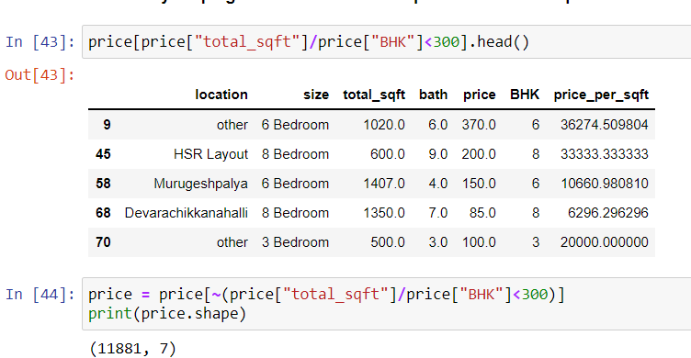
Bengaluru house data
And then i analyses the bedroom size and total_sqft for the house, by which i came to know some values were suspicious. Then i removed them considering as outliers.

Slide 10
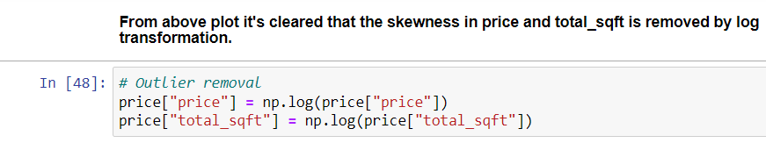
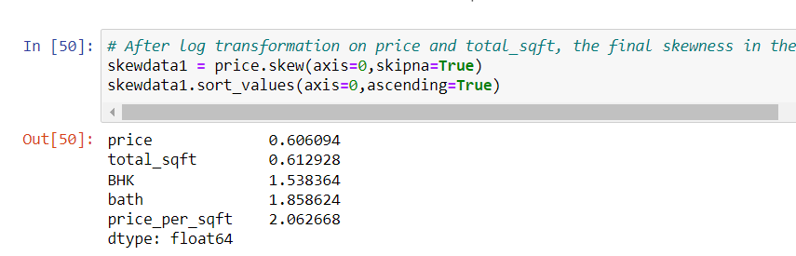
Bengaluru house data
I analysed the plot between price and total_sqft and found that the graph was right skewed, which was handle through log transformation on both of them.

Slide 11
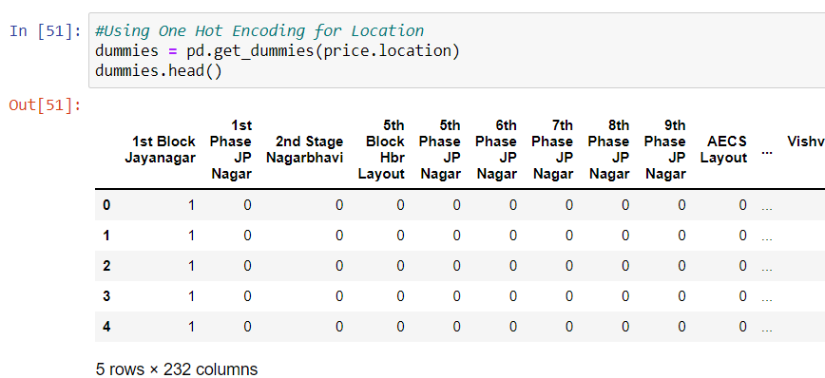
Bengaluru house data
One hot encoding was performed on location data.

Slide 12
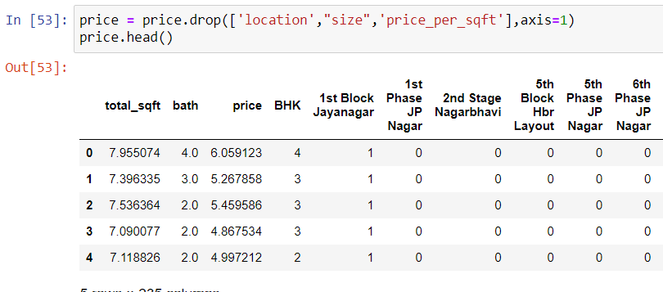
Bengaluru house data
At last for model building, i dropped the object type columns like, location, size and price_per_sqft.

Slide 13
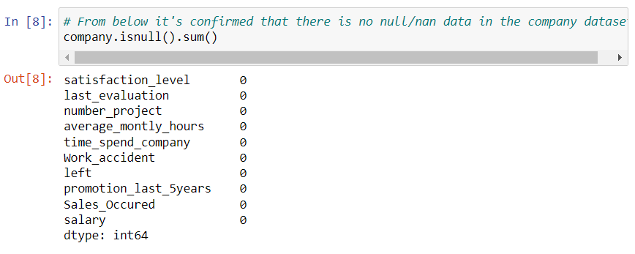
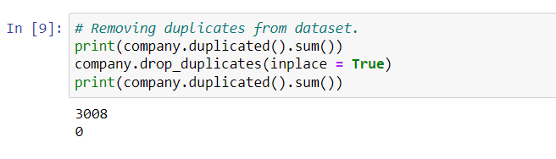
Company Attrition Data
In EDA, it was found that no null data was present. But duplicate data was present which were dropped instantly.

Slide 14
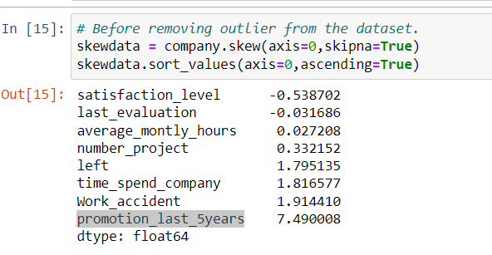

Company Attrition Data
Nearly all the columns in company data were categorical. We checked for skewness and the column promotion_last_5years was most skewed and dropped it before modelling..

Slide 15
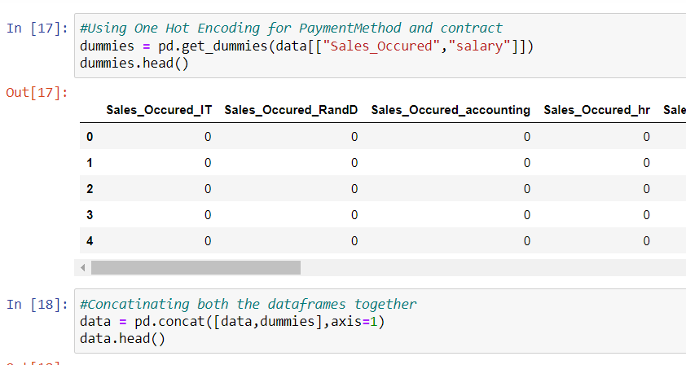
Company Attrition Data
In one hot encoding, we coded Sales_Occured and salary and concatenated with the dataset.

Slide 16

Company Attrition Data
After one hot encoding, dropped the previous column of Sales_Occured and salary.

Slide 17
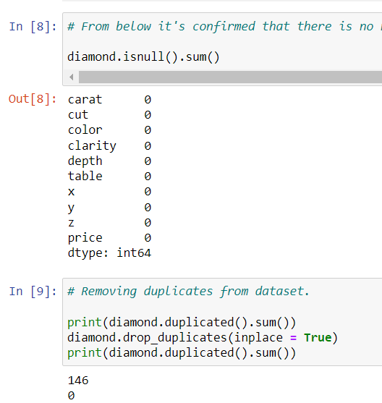
Diamond Price Prediction
In diamond dataset, during EDA it was found that there were no null values but 146 duplicate values were detected and dropped.

Slide 18
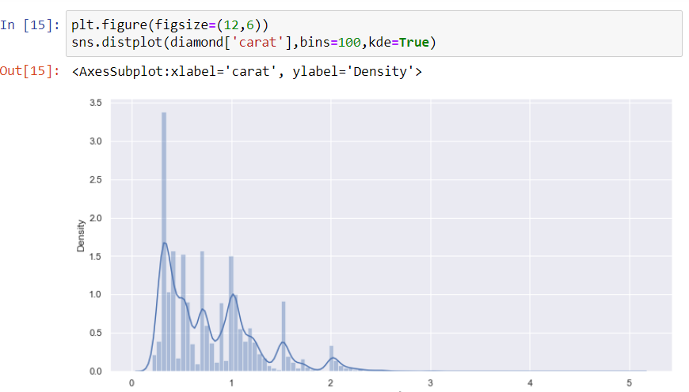
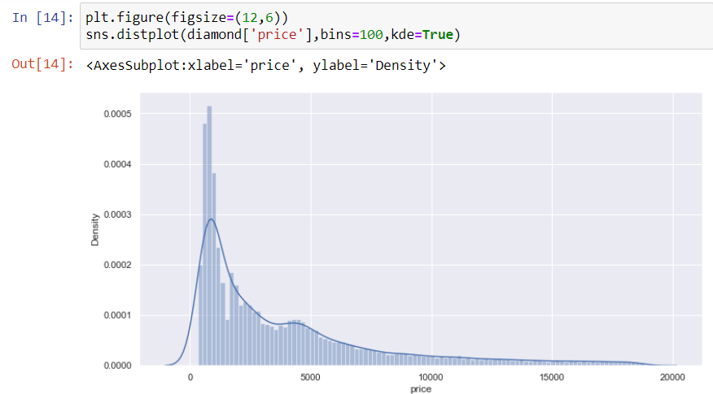
Diamond Price Prediction
In data visualisation, it was found that continuous values such as price, carat, y ,z and table were skewed.

Slide 19
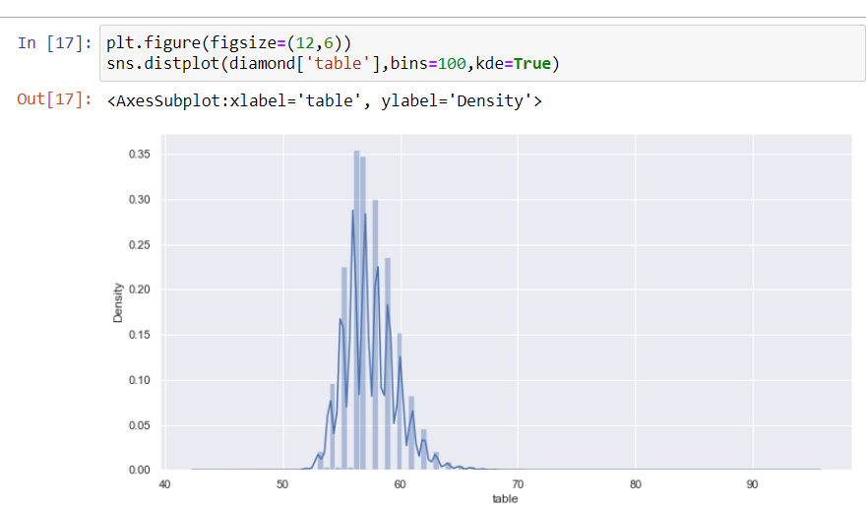
Diamond Price Prediction

Slide 20
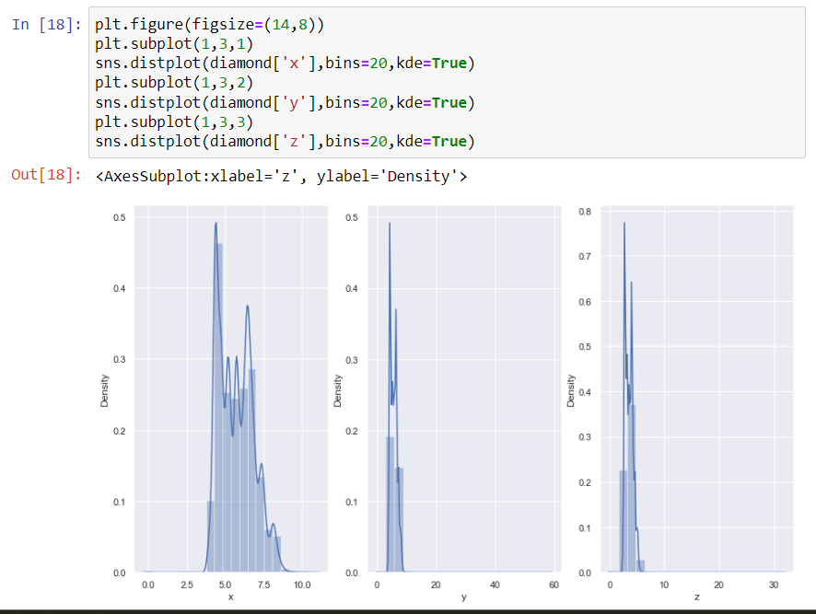
Diamond Price Prediction

Slide 21
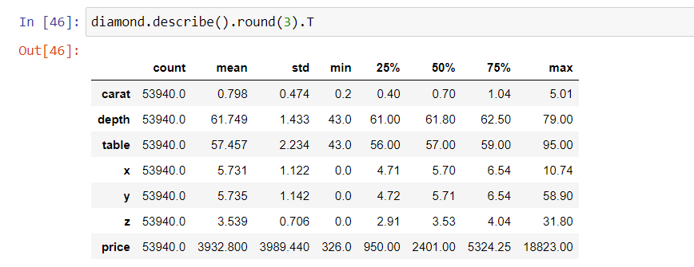
Diamond Price Prediction
From skew values and huge difference in values of quartile in describe function output.

Slide 22
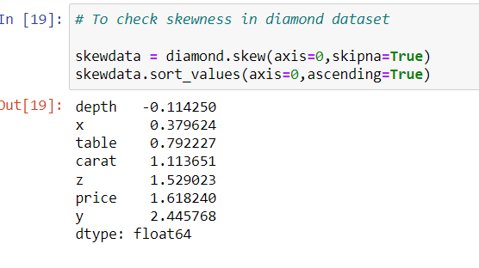
Diamond Price Prediction

Slide 23
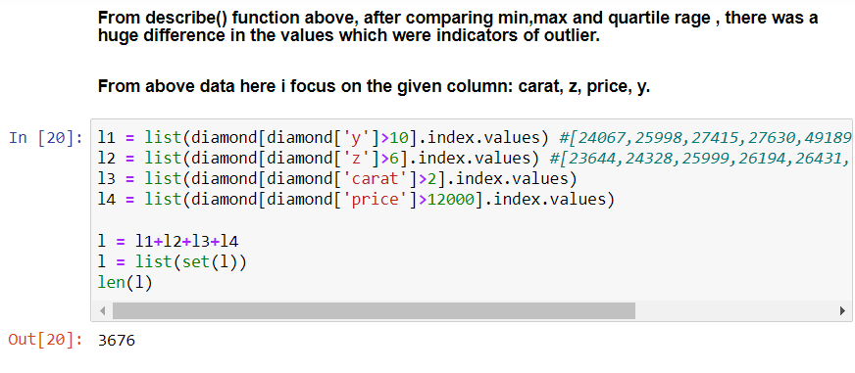
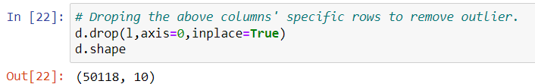
Diamond Price Prediction
So we drop a range of rows from carat, z, price, y to reduce the skewness.

Slide 24
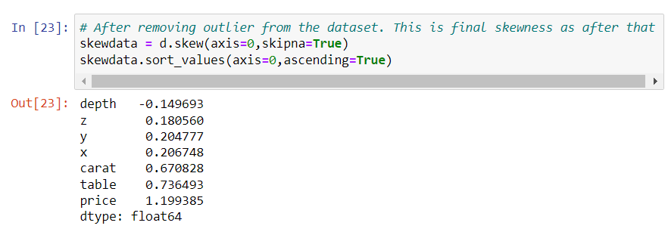
Diamond Price Prediction

Slide 25
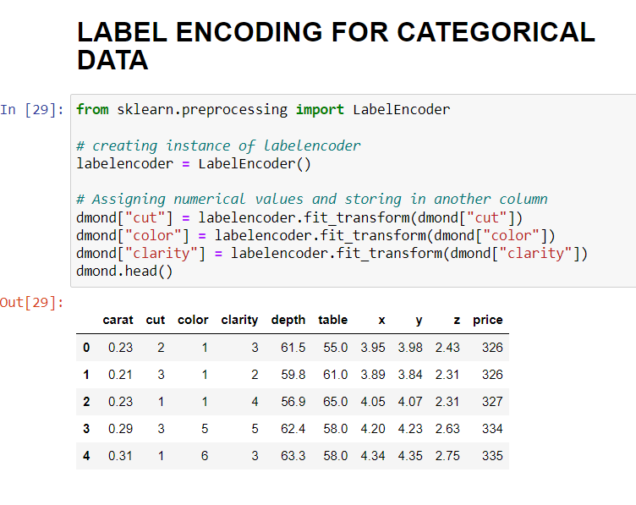
Diamond Price Prediction
Before modelling, we label encoded the cut, color and clarity column to make them int type as they were object type before.

Slide 26
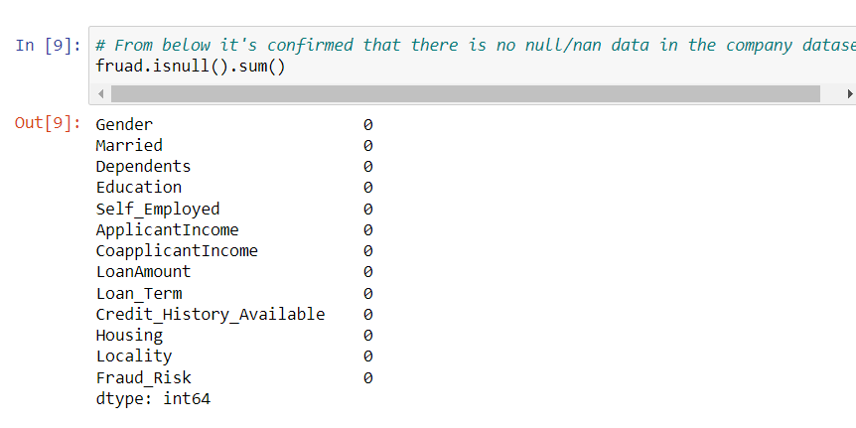
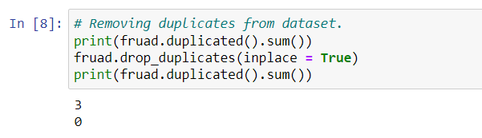
Fraud Detection
In EDA, we found out that there were zero null values and 3 duplicate values, so we dropped the null values.

Slide 27
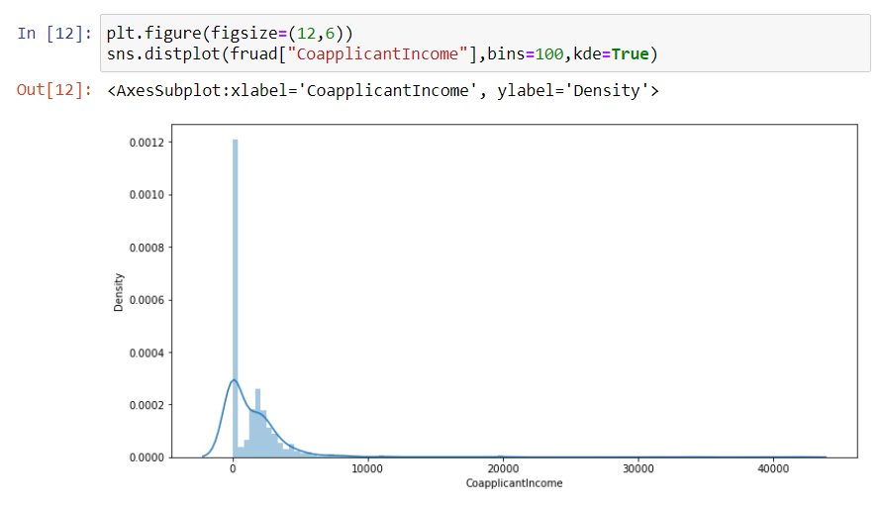
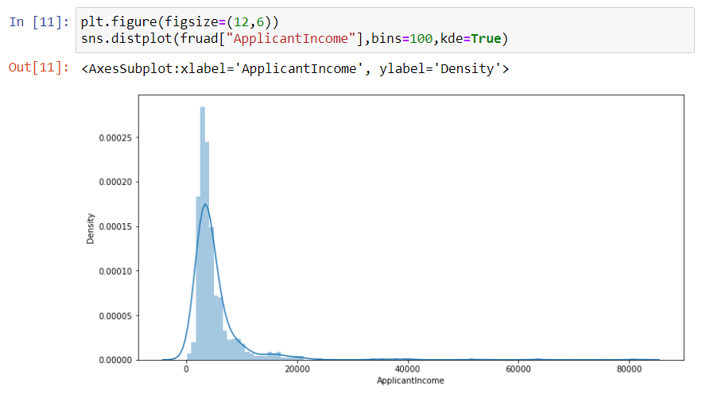
Fraud Detection
In data visualisation we found that applicantincome, loan_term,loanamount and coapplicantincome are skewed, which was confirmed by the skew value. Few more were skewed but they were categorical data so did not take action on that.

Slide 28
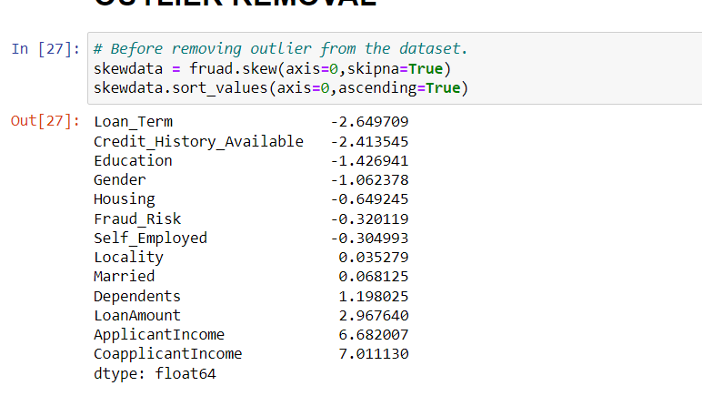
Fraud Detection
Skew values before removing outlier.

Slide 29
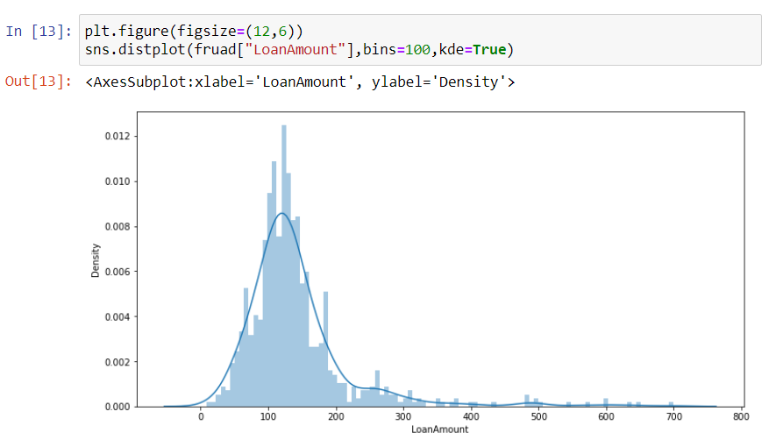
Fraud Detection
Visualisation of LoanAmount variable to show skewness as mentioned in above slide.

Slide 30
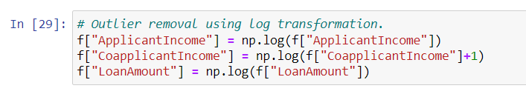
Fraud Detection
In outlier removal we performed log transformation on applicantincome,loanamount and coapplicantincome but not on loan_term as its skewness did not decreases. This significantly increases the accuracy.

Slide 31
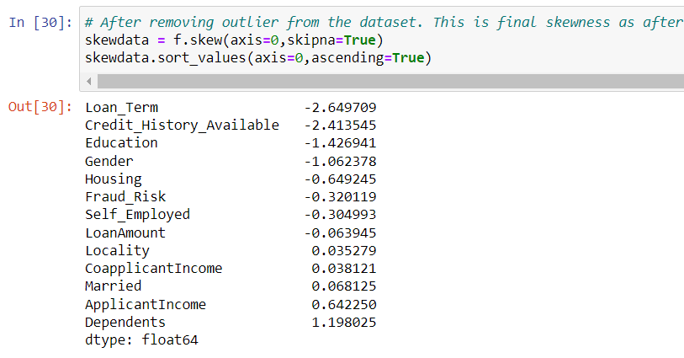
Fraud Detection
Skewness after removing outlier.

Slide 32
Business Problem
Bengaluru House data
The developed ML model in housing price prediction may facilitate the prediction of future housing prices and the establishment of policies for the real estate market. Particularly, the sellers and buyers of properties can benefit from this study and make better-informed decisions regarding the property evaluation.
Fraud Detection
Machine learning models are able to learn from patterns of normal behavior. They are very fast to adapt to changes in that normal behaviour and can quickly identify patterns of fraud transactions. This means that the model can identify suspicious customers even when there hasn't been a chargeback yet.

Slide 33
Business Problem
Company Attrition Data
HR can use the employee data to predict attrition, the possible reasons behind it and can take appropriate measures to prevent it.
Diamond Price Prediction
Diamond is one of the strongest and the most valuable substances produced naturally as a form of carbon. However, unlike gold and silver, determining the price of a diamond is very complex because many features are to be considered for determining its price. ML models are best ways to predict them.

Slide 34
Conclusion

Slide 35
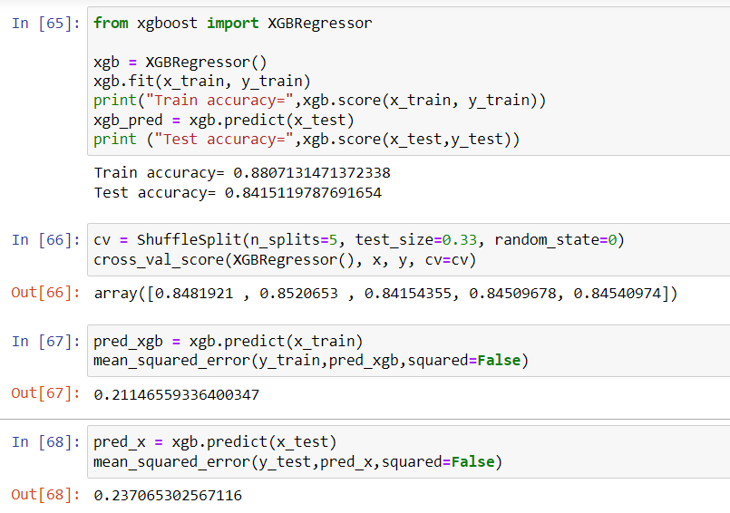
Bengaluru House data
I used linear regression, Random forest regression, XGboost regressor. And the XGboost regressor gives the best results. I used the RMSE(root mean squared error) as a accuracy metrics and XGboost regressor gives the least RMSE.

Slide 36
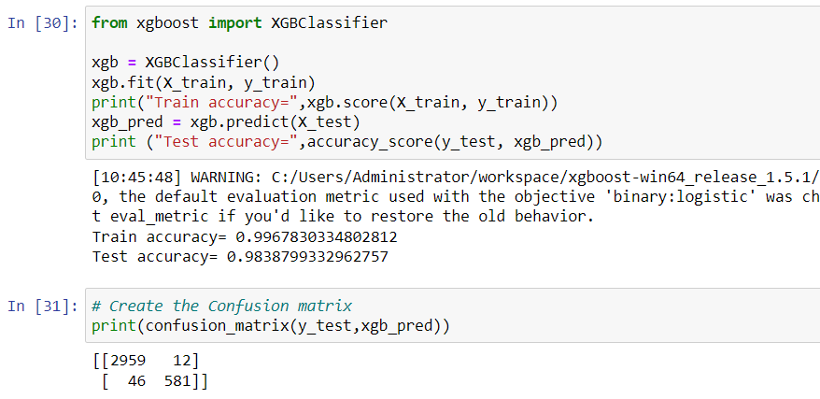
Company attrition data
I used Random forest classifier, Adaboost classifier, XGboost classifier. And the XGboost classifier gives the best results. I used the accuracy_score from sklearn.metrics library as a accuracy metrics and XGboost classifier gives the maximum accuracy score compared to other model. And confusion matrix of XGboost classifier gives max true and minimum false classification.

Slide 37
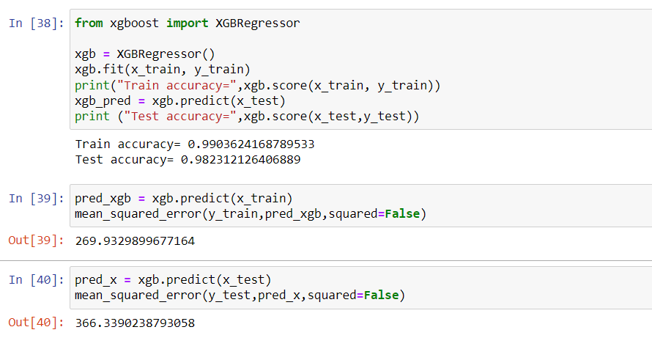
Diamond price prediction
I used linear regression, Random forest regression, XGboost regressor. And the XGboost regressor gives the best results. I used the RMSE(root mean squared error) as a accuracy metrics and XGboost regressor gives the least RMSE.

Slide 38
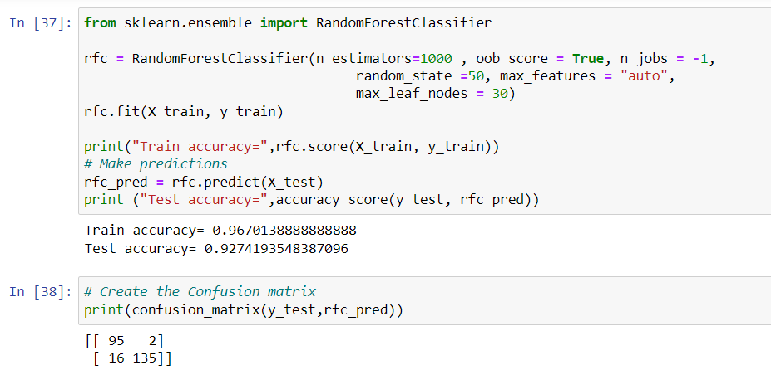
Fraud dataset
I used Random forest classifier, Adaboost classifier, XGboost classifier. And the Random forest classifier gives the best results. I used the accuracy_score from sklearn.metrics library as a accuracy metrics and Random forest classifier gives the maximum accuracy score compared to other model. And confusion matrix of Random forest classifier gives max true and minimum false classification.

Slide 39
References
https://reinec.medium.com/my-notes-handling-skewed-data-5984de303725
https://towardsdatascience.com/skewed-data-a-problem-to-your-statistical-model-9a6b5bb74e37
https://www.analyseup.com/python-data-science-reference/seaborn-continuous-variables.html
https://stats.stackexchange.com/questions/315462/removing-skew-from-ordinal-variables
https://pandas.pydata.org/docs/reference/frame.html
https://scikit-learn.org/stable/modules/classes.html#module-sklearn.ensemble
[1] S. B. Jha , R. F. Babiceanu, V. Pandey , R. K. Jha, “Housing Market Prediction Problem using Different Machine Learning Algorithms: A Case Study”, arXiv:2006.10092
[2 ]https://www.ravelin.com/insights/machine-learning-for-fraud-detection#:~:text=Machine%20learning%20models%20are%20able,t%20been%20a%20chargeback%20yet.
[3] https://analyticsindiamag.com/predictive-attrition-model/
[4]H. Mihir, M. I. Patel, S. Jani and R. Gajjar, "Diamond Price Prediction using Machine Learning," 2021 2nd International Conference on Communication, Computing and Industry 4.0 (C2I4), 2021, pp. 1-5, doi: 10.1109/C2I454156.2021.9689412.

Slide 40
Thank You

